Slide 1
An Opinionated Platform for Simplified Enterprise Application﻿ Deployment
Drew Leske and Archie To, University of Victoria

Slide 2
Agenda
RC2
Introduction and Overview
Architecture
Walkthrough
Demo
Next Steps
Questions

Slide 3
Introduction and Overview

Slide 4
What is STRAP?
STRAP: Simplified Teaching and Research Application Platform
Platform for easily deploying web applications
The basic idea: bring me your web application in a container, and I’ll give you authentication and authorization for your app, a database, storage, and deploy it with TLS and a pretty okay globally accessible URL

Slide 5
Who we are
ARC Software Development Team: a new team (16 months) developing software for research
Research Computing Services:
  Research Infrastructure
  Research Support
  Research Information Security
  Research Software
Infrastructure Services, University Systems
Notes:
This is where we introduce ourselves briefly

Slide 6
Why STRAP?
Small development team: we want to enable clients’ applications even if we can’t commit to developing them
A lot of our researchers need to develop, or already have, web applications for sharing their research outcomes
  Where are these or where are they going to go?
  Who’s looking after it?
What do you need when you build and deploy web applications?
  User accounts
  Database
  Maybe local storage
  Or maybe object storage. Backups probably but who cares we’ll worry about that later. Oh yeah and somebody needs to deploy the thing on another thing and maintain that thing
Notes:
I hate using the word “products” but researchers need a way to not just share papers and conclusions, but digital artefacts, data sets, etc.

Slide 7
Why STRAP?
Researchers need to do research
Researchers might need to write software
Researchers should not operate infrastructure
  Databases: infrastructure
  Identity management: infrastructure
  Networked storage: infrastructure
  Servers: infrastructure
We have infrastructure experts
Better security through recognition of expertise: sometimes staying in your lane isn’t a bad thing.

Slide 8
Project status
In active development
Basic team-internal apps have been running on it for months
RCS applications recently deployed
First researcher project to be deployed this summer

Slide 9
STRAP Architecture

Slide 10
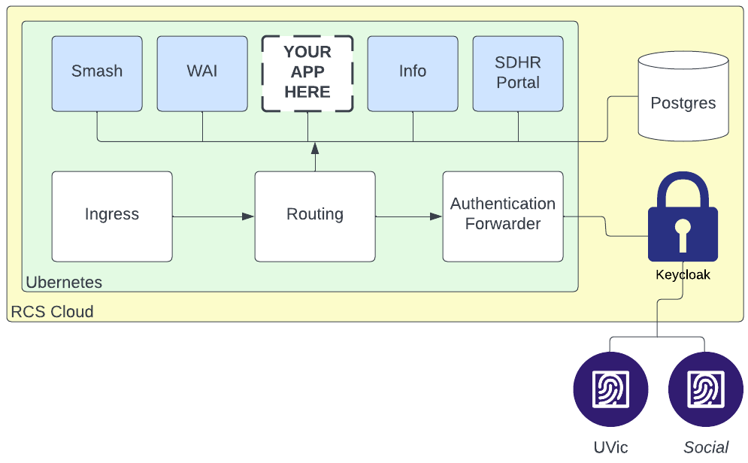
Architectural Overview

Slide 11
Architectural Elements
RCS Cloud: OpenStack instance managed by UVic’s cloud experts
Ubernetes: Opinionated Kubernetes deployment based on Kubespray
Ingress and routing: Traefik Kubernetes resources
Authentication forwarder: Traefik and 3rd-party middleware
Various apps in their own namespaces
Database: Postgres
KeyCloak: Proxies authentication to UVic or social identity providers; provides OIDC client to STRAP
Identity providers: UVic IdP, GitHub, GitLab, Twitter, Google, etc.

Slide 12
Hidden Elements (under the hood)
Terraform: Infrastructure-as-code manages all the non-static resources
Helm: Manages the Kubernetes resources
Wildcard DNS entry and wildcard TLS certificate mean we don’t have to manage these resources
  So long as everybody’s happy with the domain we give them
  Yeah, we’ll have to handle bespoke domains at some point
  These are actually managed with Terraform, just currently manually, outside of STRAP, such as when the Let’s Encrypt wildcard certificate needs to be renewed
Object store (currently Minio) for storing Terraform state
  Object storage will be configurable option for STRAP applications in the future

Slide 13
More on authentication
Application routes can be configured as authenticated or unauthenticated
STRAP uses an OIDC client middleware to authenticate to KeyCloak
KeyCloak proxies authentication to desired identity provider
  App deployer can specify UVic identities, or UVic and social identities allowed
If authentication is successful, the middleware sets an HTTP header “X-Forwarded-User” to the authenticated user’s e-mail address provided
If authentication is unsuccessful, access to the authenticated route is denied
Access to unauthenticated routes will be granted, but if previously authenticated, user identity is still available
All the application has to do for user authentication is to read that header.

Slide 14
STRAP Walkthrough

Slide 15
How deployment works
The user defines their application using another app called Strapper, which combines the app definition and parameters describing the STRAP instance into a Terraform definition.
This definition is a specialization of the STRAP Terraform module.
Terraform creates a plan of what the end result should be and compares against the existing state, if any.
For a new app, there will be no state; all resources will be created.
For an updated app, for example an updated image tag (version), only necessary resources will be updated.
Terraform provides outputs back to the platform.

Slide 16
Deployment of a new app
Terraform creates:
  A client in KeyCloak for the required authentication realm based on the type of authentication (UVic, UVic+Social) requested
  Randomly generated passwords for three database roles
  A database in Postgres and associated roles (owner, rw, ro) using these passwords
Then instantiates a Helm chart which creates resources in Kubernetes:
  Deployment, service
  Ingress, authentication middleware
Terraform reports back:
  Status
  Databases created and associated roles and passwords

Slide 17
STRAP Screenshots

Slide 18
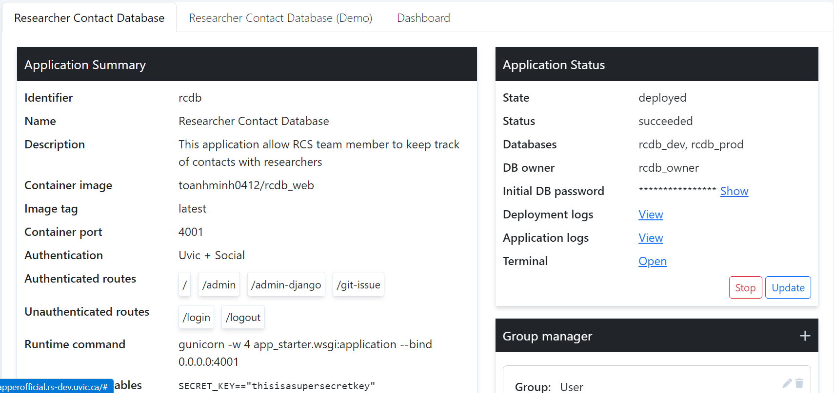
Screenshot 1

Slide 19
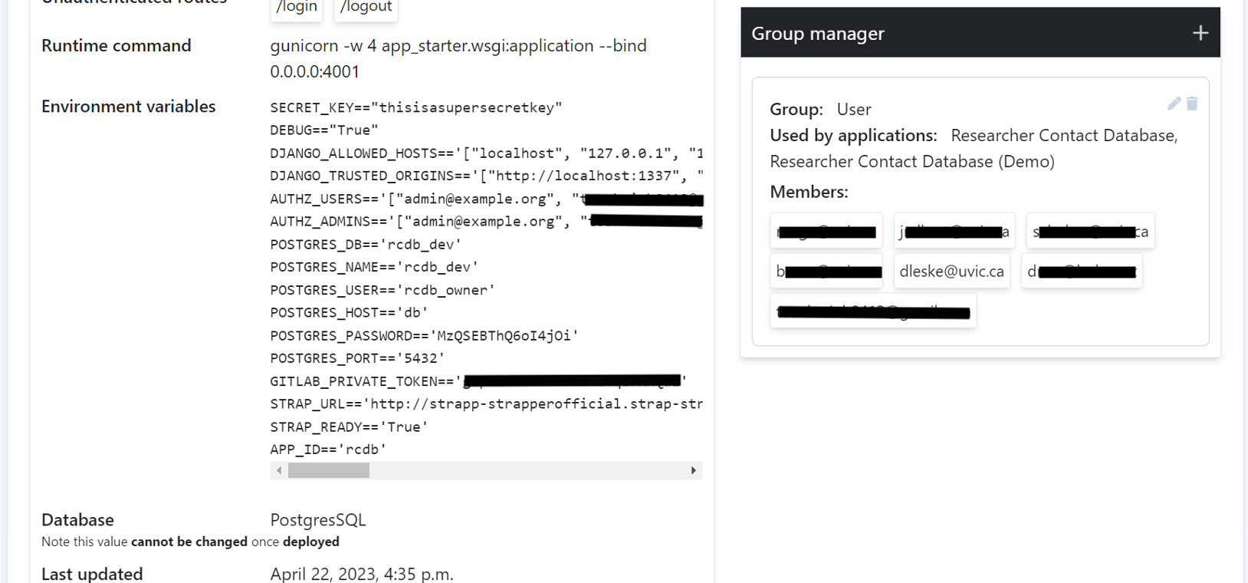
Screenshot 2

Slide 20
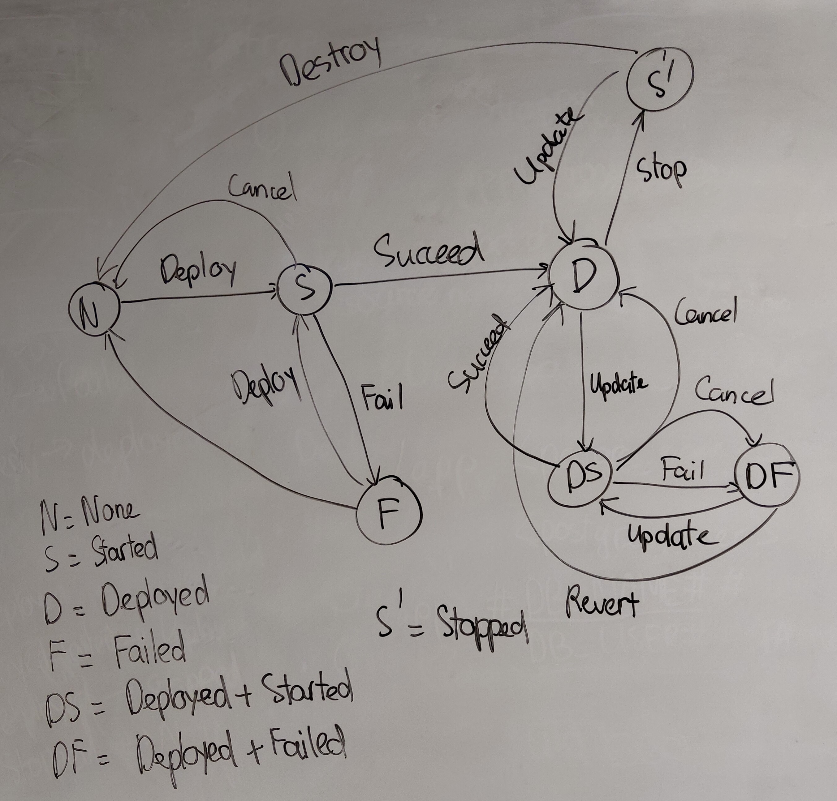
Deployment state machine
We see here some of the complexity Strapper has to deal with in updating deployments, cancelling them, or when things go wrong.

Slide 21
Next Steps

Slide 22
Future functionality and features
MySQL
File and object storage
Basic API so apps can be updated via CI jobs
Scalability, load monitoring and autoscaling… quotas
KeyCloak customization

Slide 23
Security
Who spotted a vulnerability in the platform as described today?
Platform needs more eyes on it, starting with SMEs at UVic (but hey, the code is all open)
Some plans
White-hat hacking event this summer with student group
Host our own container registry to enforce container scanning
Assemble SMEs at UVic to delve into it
Automated penetration testing of all apps

Slide 24
The future
Use expert-managed database systems
Use expert-managed object storage
Bespoke domains
Production status
Deploy more projects
Run training sessions
See it deployed elsewhere…

Slide 25
Thank you!

Slide 26
The STRAP Project
Project home page: https://arcsoft.uvic.ca/projects/strap/
Project source: https://gitlab.com/uvic-arcsoft/strap
ARC Software Development: https://arcsoft.uvic.ca
Research Computing Services: https://rcs.uvic.ca
Drew Leske dleske@uvic.ca
STRAP platform and design
Archie To
Strapper
Research Computing Services
Ubernetes & all the things
University Systems
UVic Identity
OSS community
Postgres, KeyCloak, authentication middleware, K8s, …

